Slide 1

DEEP LEARNING BASED POTHOLE DETECTION SYSTEM
Under the guidance of
Ms. Deepa D,
by
Rahul Roonwal
(39110825)
Rajeev Nayan
(39110828)

Slide 2
Presentation Outline
Introduction
Literature survey
Inferences from Literature Survey
Objectives
Flow Diagram
System Architecture
Experimental Setup
Datasets Used
Algorithms Applied
Results Obtained
Screenshots
Existing Algorithm - Comparison
References

Slide 3
Introduction
The proposed project solves the problem of pothole detection using various deep learning techniques.
It compares various deep learning models to find the best technique for predicting the damaged roads.
Algorithm with maximum accuracy is used for further implementation.

Slide 4
Literature Review
AUTHOR | YEAR OF PUBLICATION | DESCRIPTIONS | PROS | CONS
Anup Kumar Pandey | 2022 | Predicting the damaged roads using accelerometer and CNN model. | Used ID-CNN model | Other methods not used for maximum accuracy
Deepak Kumar Dewangan | 2020 | Pothole detection for Autonomous Vehicle System using CNN | Used CNN model | Latest Models not used
Yuan Yuan | 2020 | Using Image recognition technologies | Used deep learning techniques | Limited methods used

Slide 5
Literature Review
AUTHOR | YEAR OF PUBLICATION | DESCRIPTIONS | PROS | CONS
Nachuan Ma | 2022 | Using Computer Vision for Road imaging and Pothole Detection | Used many sensors and devices | Not used Yolo V5
Ratnajit Mukherjee | 2021 | AI based road inspection system | Used RGPNet model | Used only one method
Dharneeshkar J | 2020 | Detection of Potholes using Yolo | Used various Yolo models | Latest Yolo model not used

Slide 6
Literature Review
AUTHOR | YEAR OF PUBLICATION | DESCRIPTIONS | PROS | CONS
Byeong-ho Kang | 2017 | Used 2D LiDAR and Camera for pothole detection | Used LiDAR sensors and camera for real time detection | Basic image based algorithms used
Kavitha R | 2021 | Pothole detection using Yolo | Used Yolo model | Other models not used
K. Vigneshwar | 2016 | Counting of potholes using image processing techiques | Used Gaussian Filtering model | Latest models not used

Slide 7
Inferences from Literature Survey
Based on the studies from the literature survey, it is noted that the pothole detection problem is solved using various algorithms.
Different approaches are followed but with less accuracy and only some algorithms are used in a particular approach.
Latest deep learning models are not used.

Slide 8
Objectives
To apply and compare different machine learning and deep learning algorithms on the given dataset.
To predict the damaged roads using CNN and Yolo v5 algorithms.
To predict which part of the road needs repairing for proper maintenance.
To visualize the various techniques and using the relative best algorithm with maximum accuracy.

Slide 9
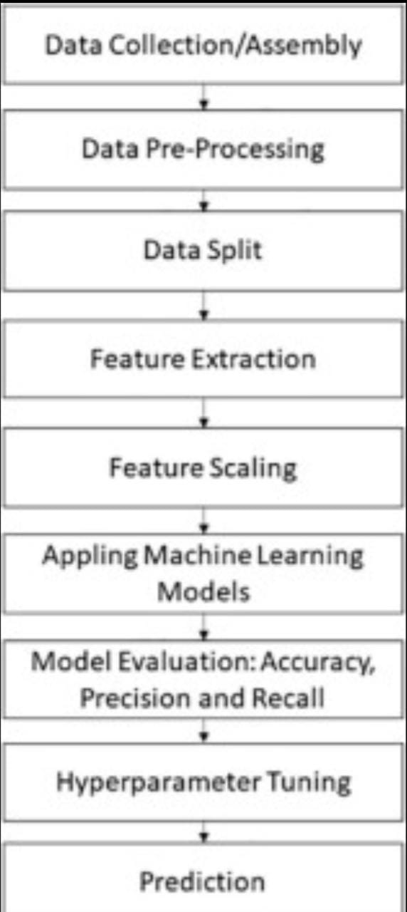
FLOW DIAGRAM

Slide 10
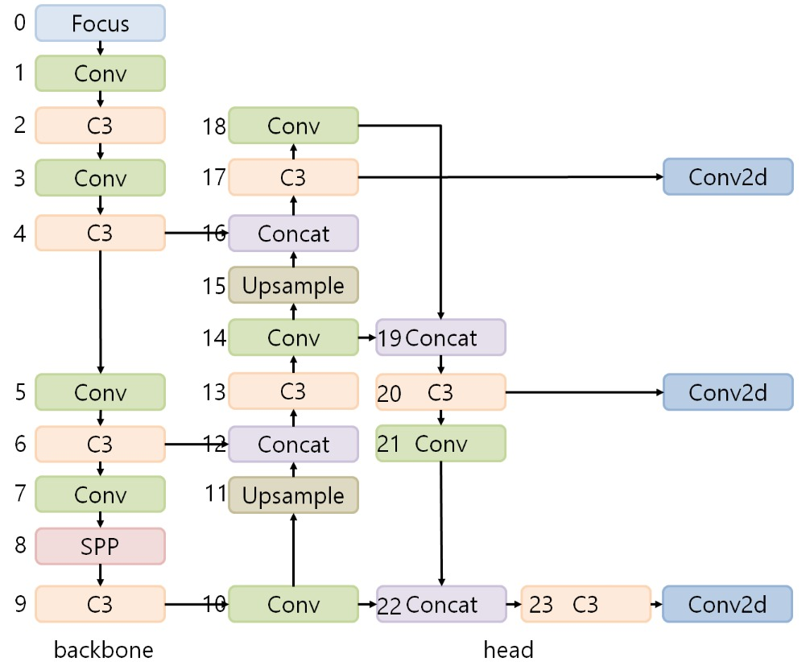
System Architecture

Slide 11
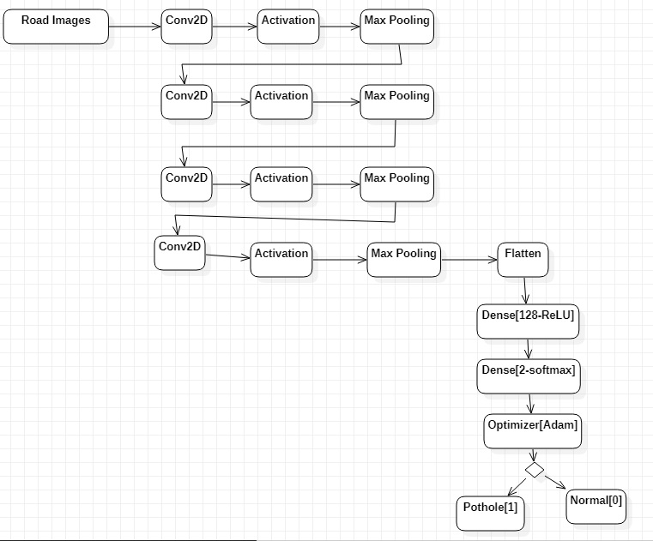
System Architecture

Slide 12
Description of Software for Implementation
Python - Used to build software,data analysis, etc.
Juypter Notebook - Used for creating and sharing computational documents.
Google Colab - Used to write and execute arbitrary python code through the browser.
VS Code – It is a source code editor for compiling our code.

Slide 13
Experimental Setup
In order to do this project, we are using a Computer System with a RAM of 8GB for faster processing and various other softwares as well.
The various softwares used are Juypter Notebook, Google Colab and VS code.

Slide 14
Datasets Used
For YOLO v5 algorithm, the dataset is imported from the Roboflow website. It is a website which provides datasets in different format options.
For the CNN algorithm used, the dataset is downloaded from the Kaggle website. In this dataset, there are plain images as well as images with potholes.

Slide 15
Algorithms Applied
To predict the potholes, various algorithms are used and the algorithm with the highest accuracy is found out.
The various algorithms used are CNN and YOLO v5 and by implementing both these algorithms, the model with the highest accuracy is found out.

Slide 16
Results Obtained - CNN
In CNN, the dataset used was containing a total of 960 images, 486 – plain images and 474 – pothole images.
Here, 768 images were passed for training and the remaining 192 images were used for testing.
The accuracy obtained using CNN model was 93.34%

Slide 17
Results Obtained – YOLO v5
In CNN, the dataset used was imported from the Roboflow website.
Here, a total of 465 images were used for training and the training was done on different epochs and batch sizes.
The epoch value with the best accuracy was taken into consideration.
The accuracy obtained using this model was 73.34%

Slide 18
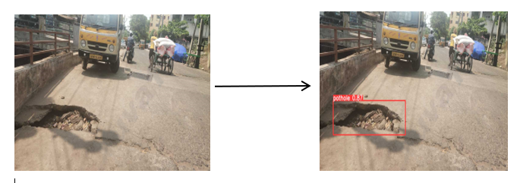
Screenshots
In the below image, the pothole is found out using the Yolo v5 algorithm.

Slide 19
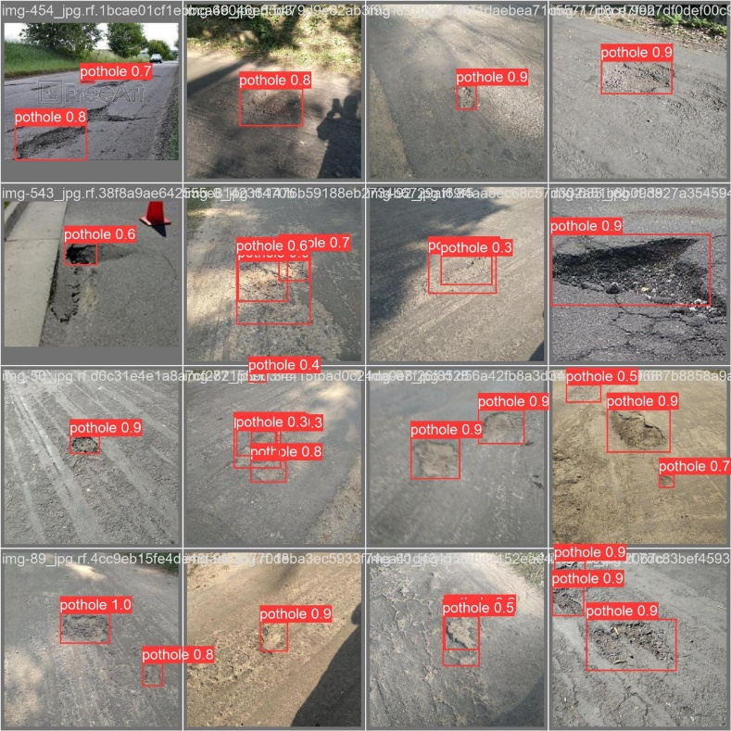
Screenshots
In the below image, the pothole is found out using the various algorithms.

Slide 20
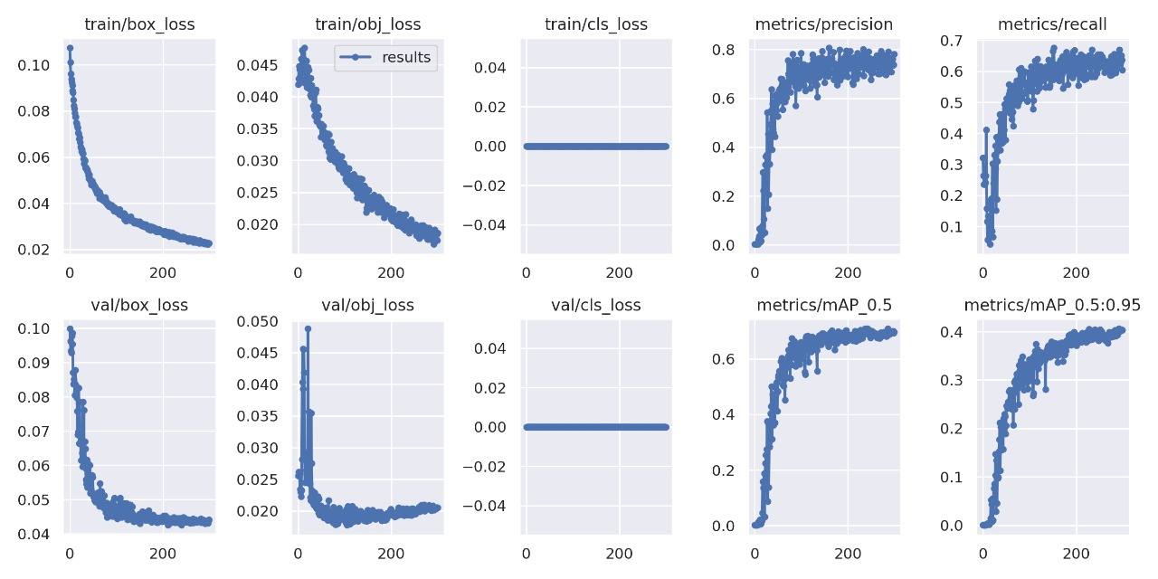
Screenshots

Slide 21
Existing Algorithm – Comparison
In our algorithm, we trying to increasing the accuracy by training the model using a large dataset.
Also, we are using various algorithms to train our model such as CNN, YOLO v5, etc.
The algorithm with the highest accuracy is used further.

Slide 22
References
[1]Anup Kumar Pandey, Rahat Iqbal, Tomasz Maniak, Charalampos Karyotis, Stephen Akuma, Vasil Paladea, Convolution neural networks for pothole detection of critical road infrastructure.
[2] Deepak Kumar Dewangan, Satya Prakash Sahu, PotNet: Pothole detection for autonomous vehicle system using convolutional neural network.
[3] Yuan Yuan, Lei Chen, Huarui Wu, Lin Li, Advanced agricultural disease image recognition technologies.
[4] Nachuan Ma, Jiahe Fan, Wenshuo Wang, Jin Wu, Yu Jiang, Lihua Xie and Rui Fan, Computer Vision for Road Imaging and Pothole Detection: A State-of-the-Art Review of Systems and Algorithms.
[5] Ratnajit Mukherjee, Haris Iqbal, Shabbir Marzban, Ahmed Badar, Terence Brouns, Shruthi Gowda, Elahe Arani and Bahram Zonooz, AI Driven Road Maintenance Inspection.

Slide 23
References
[6] Dharneeshkar J, Soban Dhakshana V, Aniruthan S A, Karthika R; Latha Parameswaran, Deep Learning based Detection of potholes in Indian roads using YOLO.
[7] Byeong-ho Kang and Su-il Choi, Pothole Detection System using 2D LiDAR and Camera.
[8] Kavitha R and Nivetha S, Pothole and Object Detection for an Autonomous Vehicle Using YOLO.
[9] K. Vigneshwar, B. Hema Kumar, Detection and Counting of Pothole using Image Processing Techniques.

Slide 24
THANK YOU
We thank our guide and panel and all technical and non technical staff helped us in achieving this.

